Slide 1
Robotics Project:
GuideMeBot
Noah Delvoye
Aditya Kakarlamudi
Joseph Thompson
Tybo Verslype

Slide 2
Project Goal
Robot guide
Have destinations options
Have a conversation while guiding
Avoid obstacles
Notes:
the main goals of our project were to
guide people to their destinations
to know what destination the user wants to go we have a GUI with destination options
while the user is following the robot the user has small talk with the robot to know if the user is still following
also while it is guiding the user it must avoid obstacles on its way

Slide 3
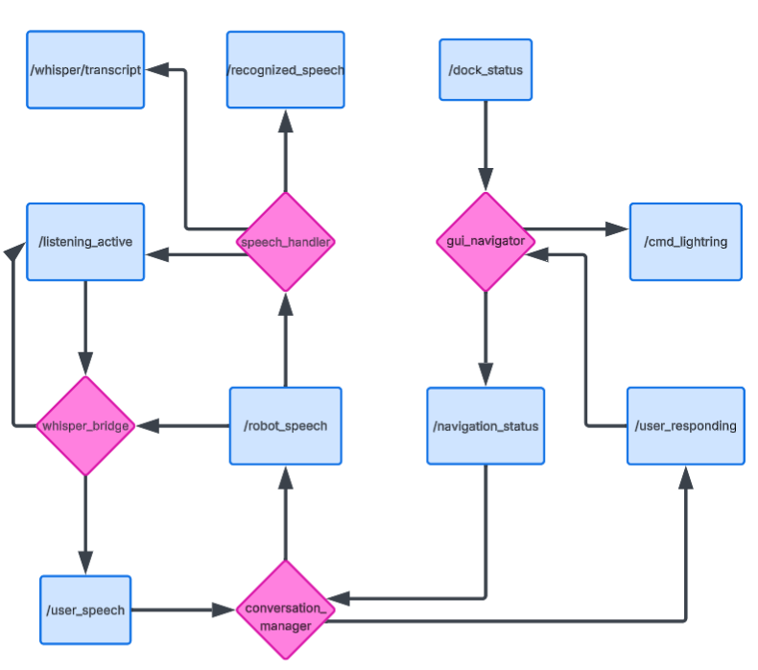
Design
LLM
NAVIGATION
Notes:
https://lucid.app/lucidchart/36247157-7e58-4217-9788-15f463371cb8/edit?viewport_loc=-619%2C-1591%2C3105%2C1486%2C0_0&invitationId=inv_356b11fd-6410-4559-b1d5-b004f079ac84
The whole project has 2 big parts we have the llm part and the navigation part we start with explaining the navigation part

Slide 4
Navigation
Undock
Start/Stop conversation
Arrival
Not followed
Notes:
when the user picks a destination
the robot undocks if necessary
Publishes that navigation has started
drives to destination while avoiding obstacles
when it arrives at destination
Publishes that navigation has ended
lights up
If user is not following
it stops its current navigation
Drives towards the dock
tries to dock

Slide 5
LLM
navigation status
Dialogflow
Notes:
conv manager subs to navigation status
in conv manager the dialogflow setup
conv manager publishes the text to be spoken
speech handler is speaking this text
whisper setup stops listening while speaking
loop:
user responds to the speech
whisper hears it and transforms to text
this text is given to the conversation manager
conversation manager generates a response
the speech handler is saying the response to the user

Slide 6
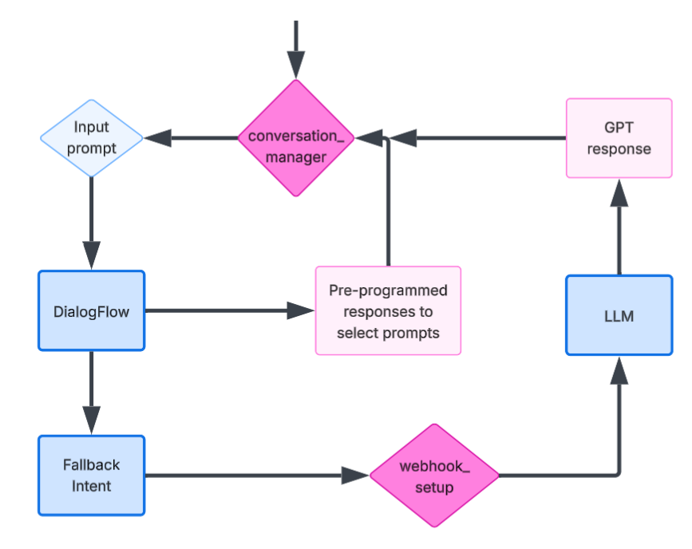
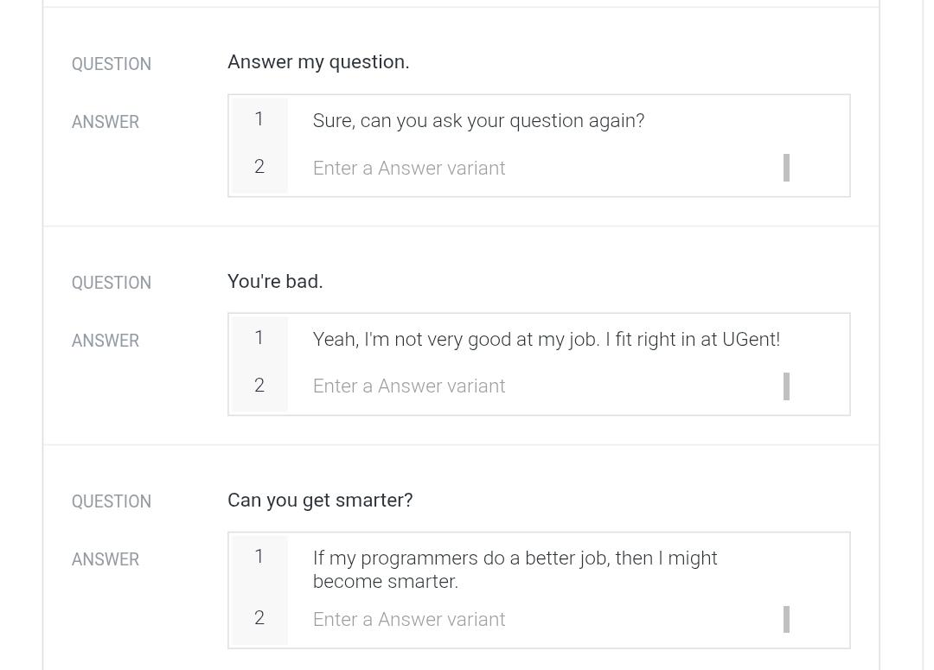
LLM
Notes:
the conversation manager recieves a prompt
the prompt is send to dialogflow where dialogflow checks if its
a message from thee pre programed prompts to give a pre programd response (to make the responses more personalized)
otherwise we go to fallback intent and send the prompt to the llm
the llm responds that conversation manager gives to the speech handler

Slide 7
Technical aspects

Slide 8
Technical aspects of our solution
Navigation
Nav2
Obstacle Avoidance
Nav2
Localization
AMCL
Socializing
Dialog Flow
Webhook
LLM (OpenAI)
Notes:
for the technical aspects we use for the
navigation, nav2 with slightly altered parameters
obstacle avoidance, nav2 already included the obstacle avoidance in its parameters
localization, we first make a static map with SLAM and then for the rest of the time we use AMCL to localize ourselfs in the map
socialization, we call dialogflow this calls the webhook and that uses a LLM (OpenAI)

Slide 9
DEMO

Slide 10
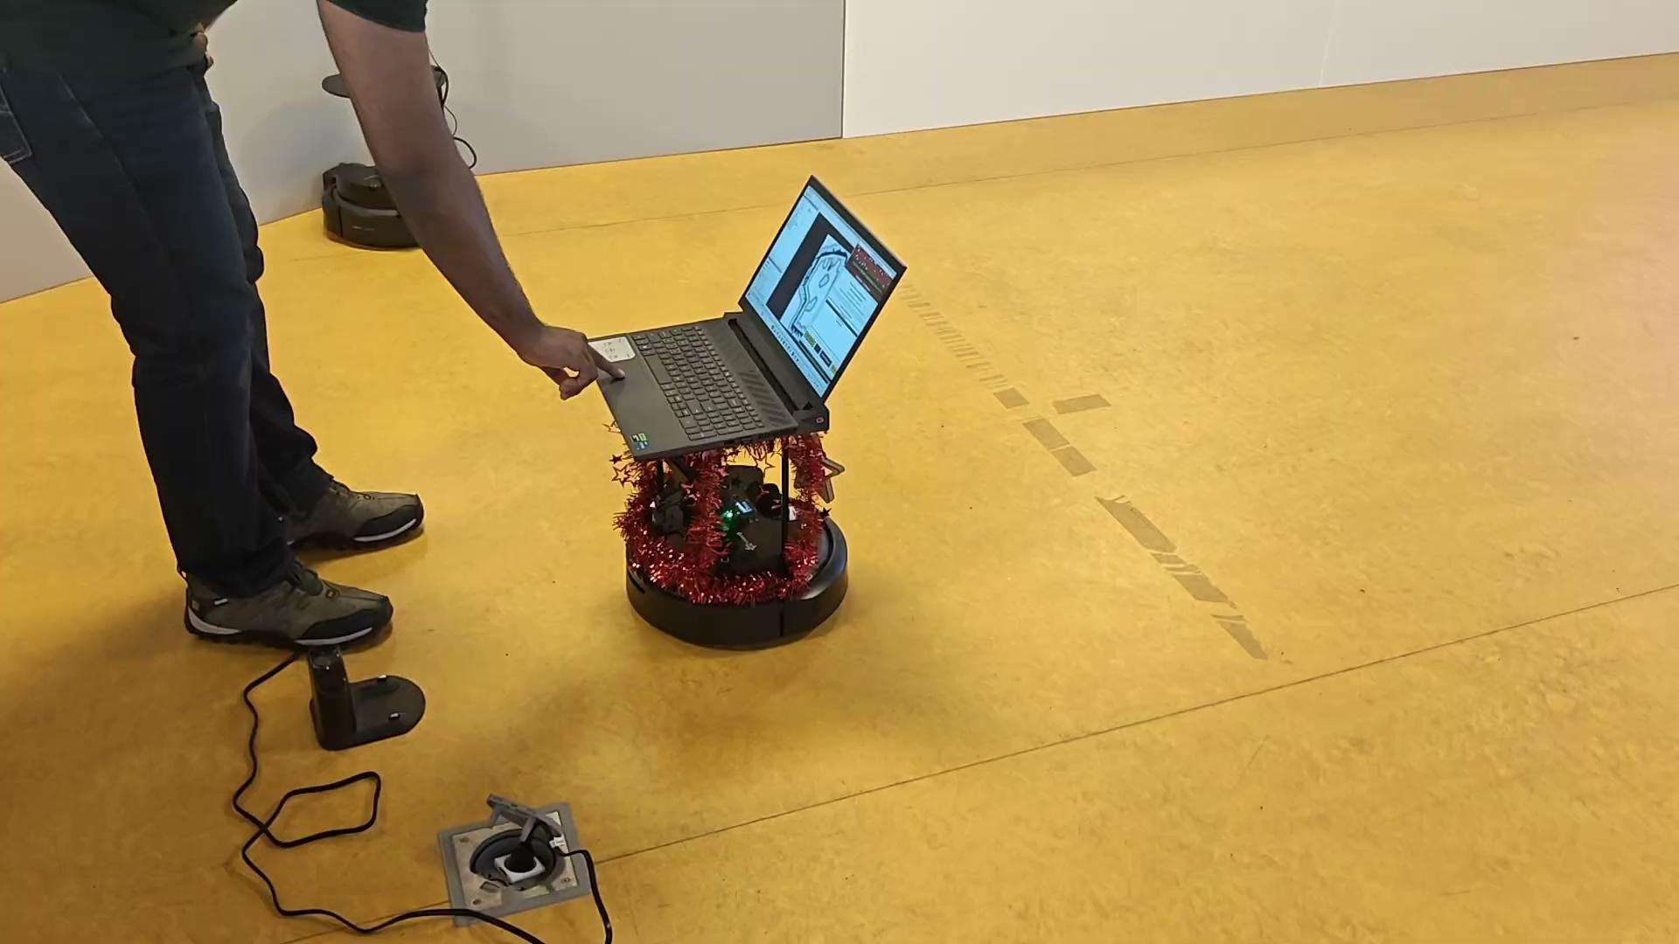
Basic Navigation

Slide 11
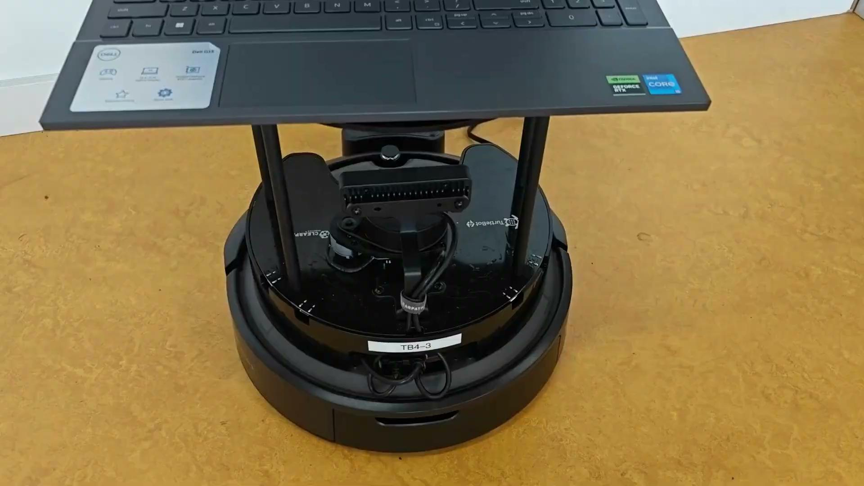
Navigation + obstacle avoidance

Slide 12
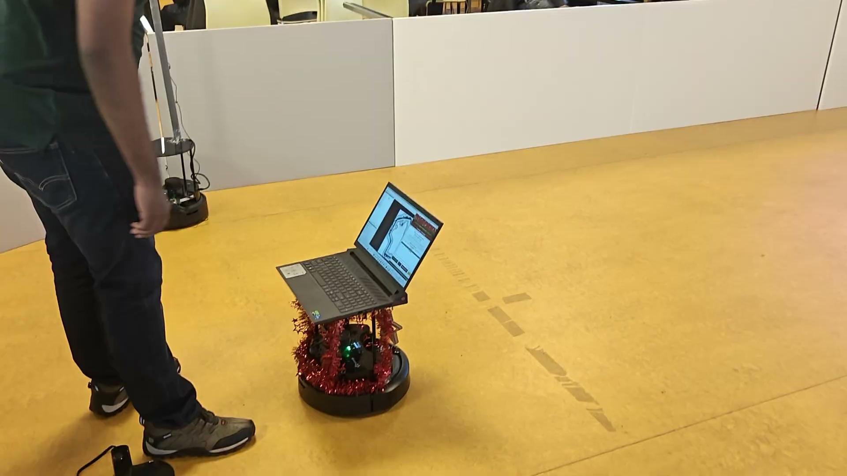
Navigation 1

Slide 13
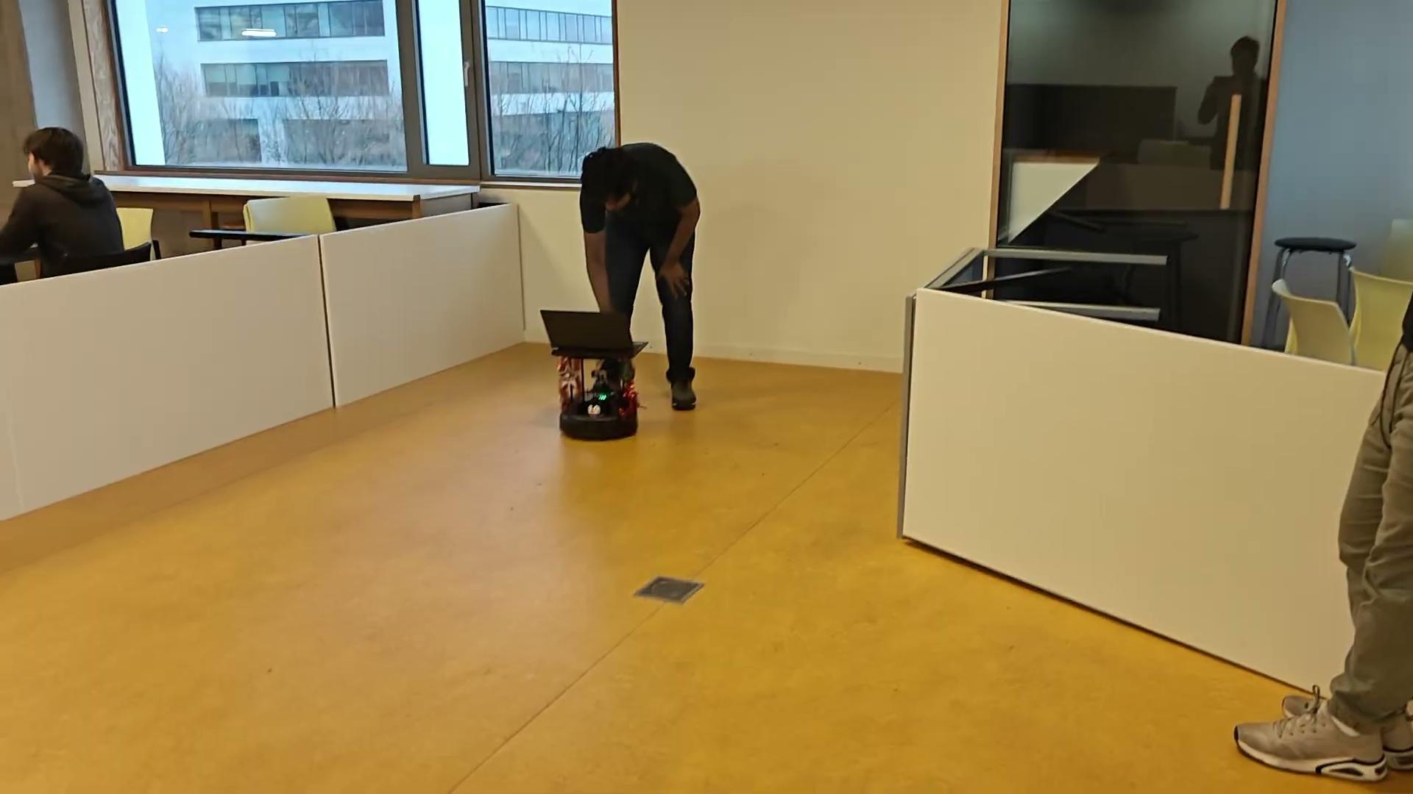
Navigation 2

Slide 14
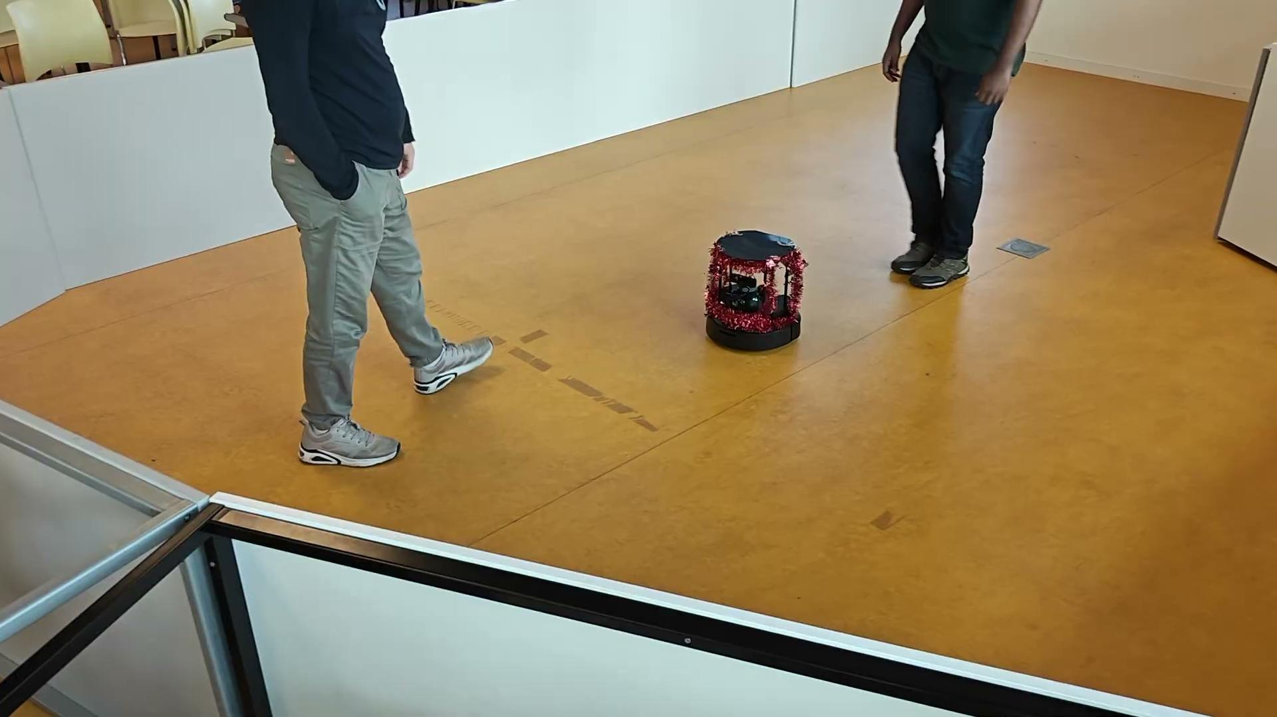
Navigation 3

Slide 15
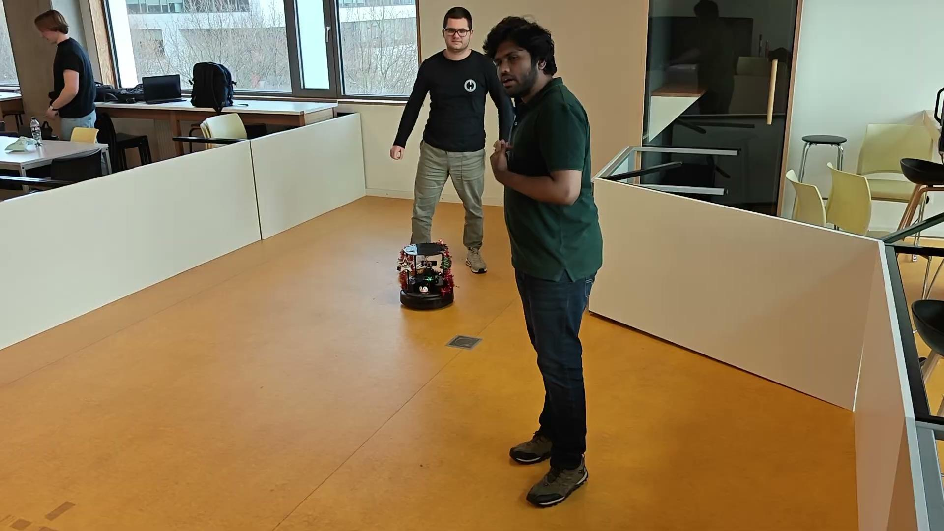
Navigation 4

Slide 16

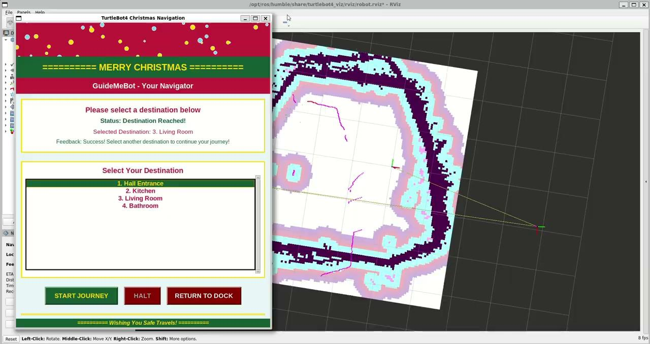
Kidnapping

Slide 17
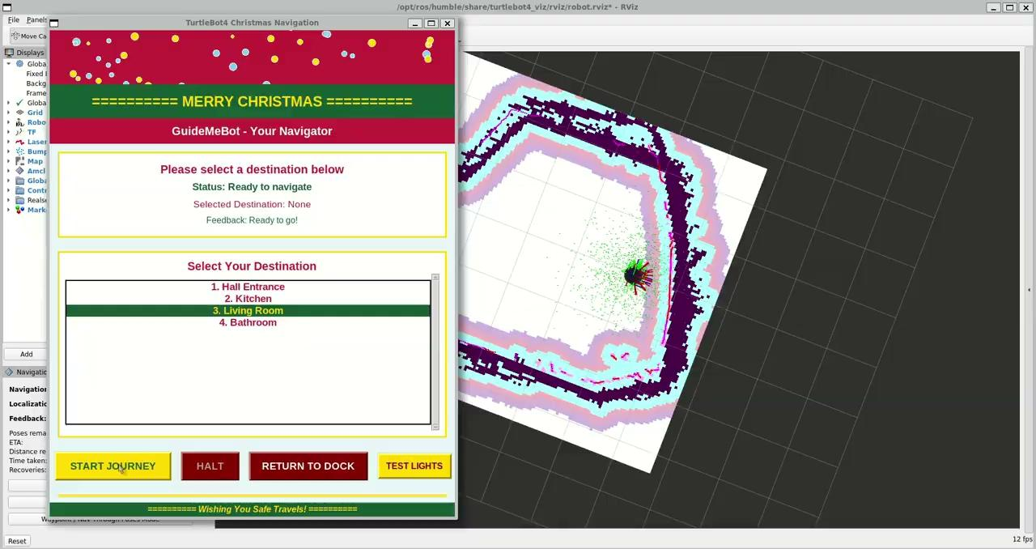
Kidnapping

Slide 18
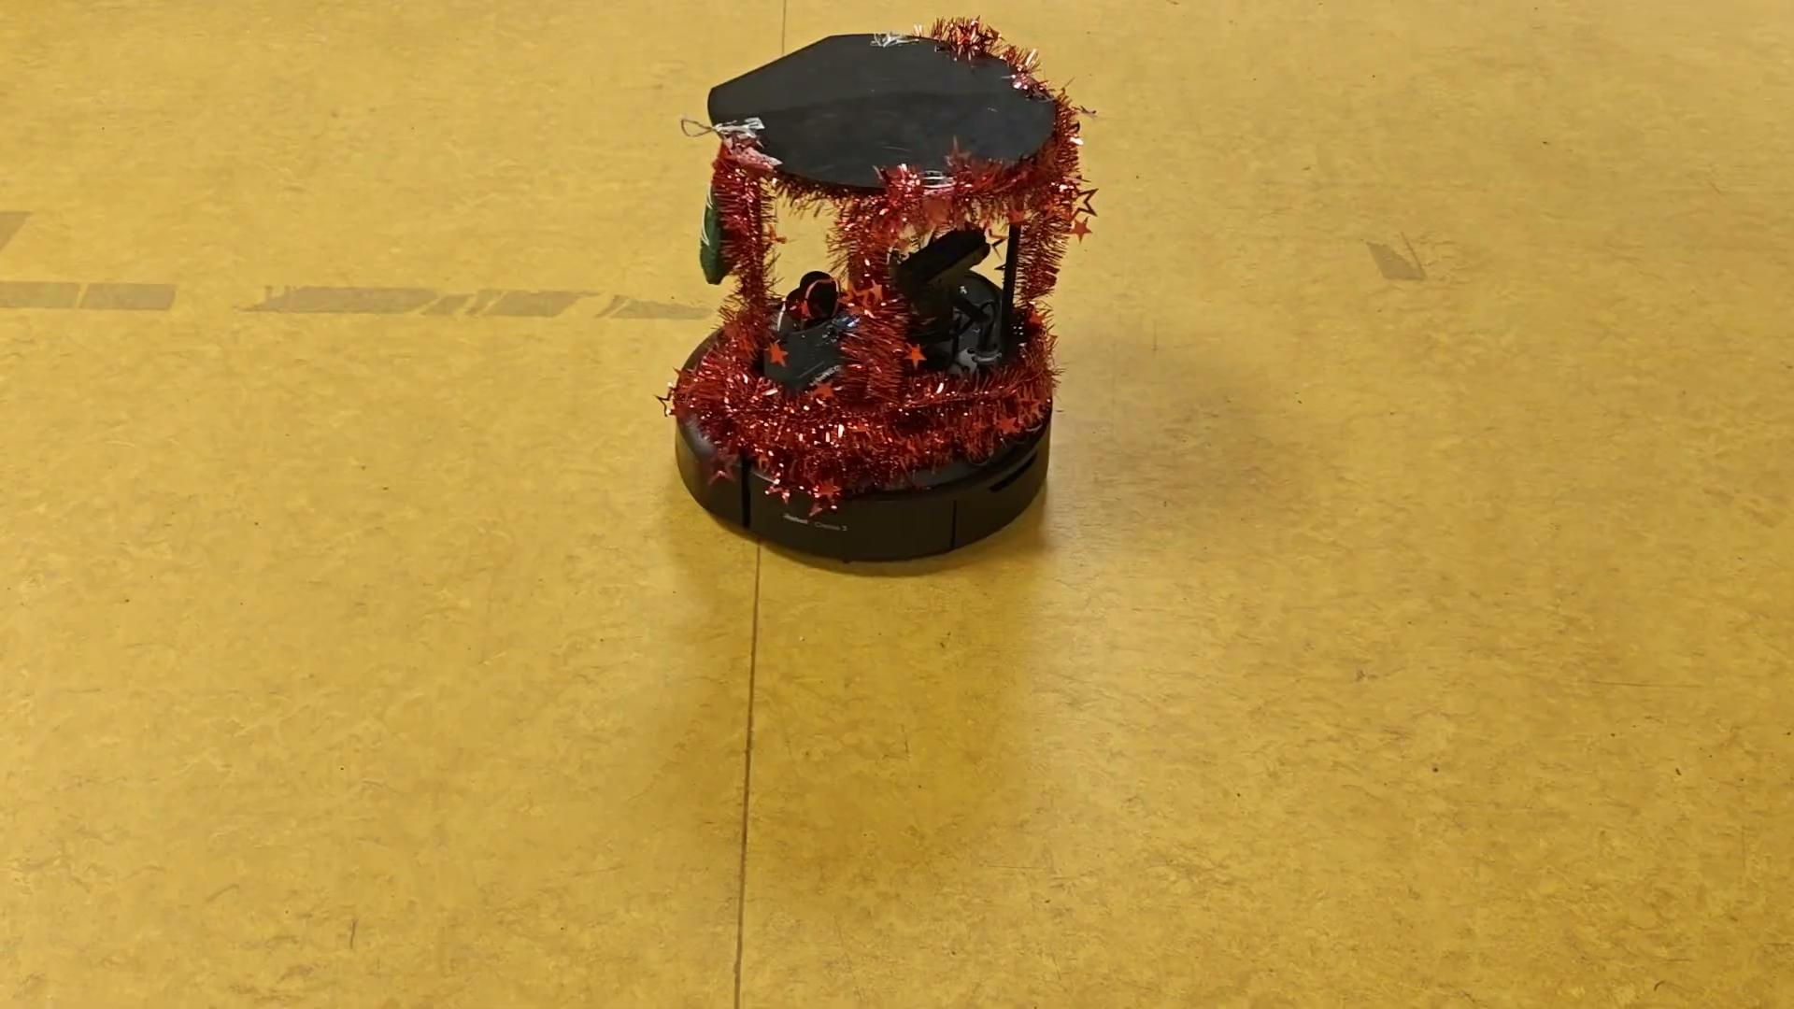
Docking

Slide 19
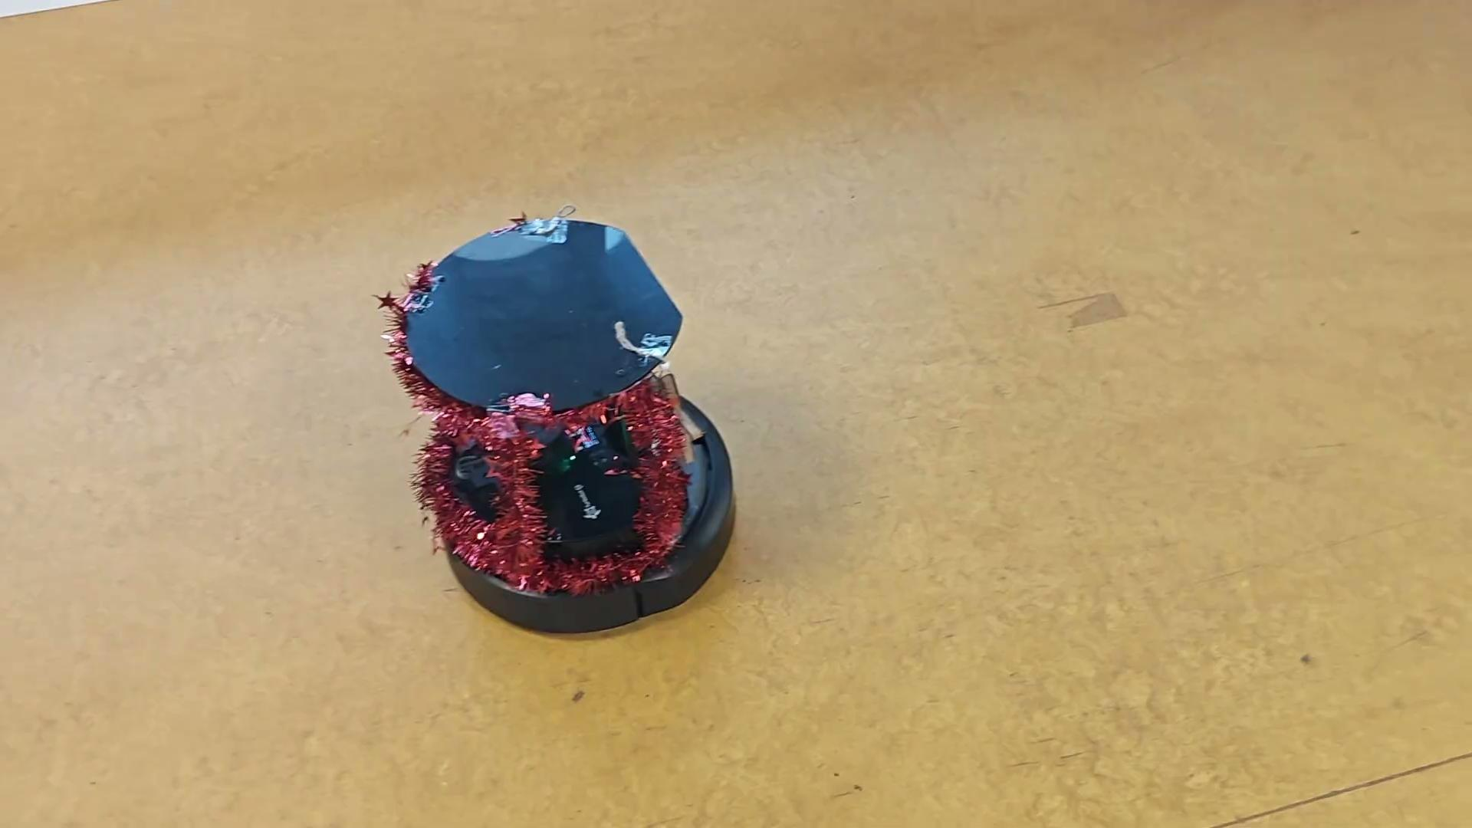
Stop navigating and dock

Slide 20
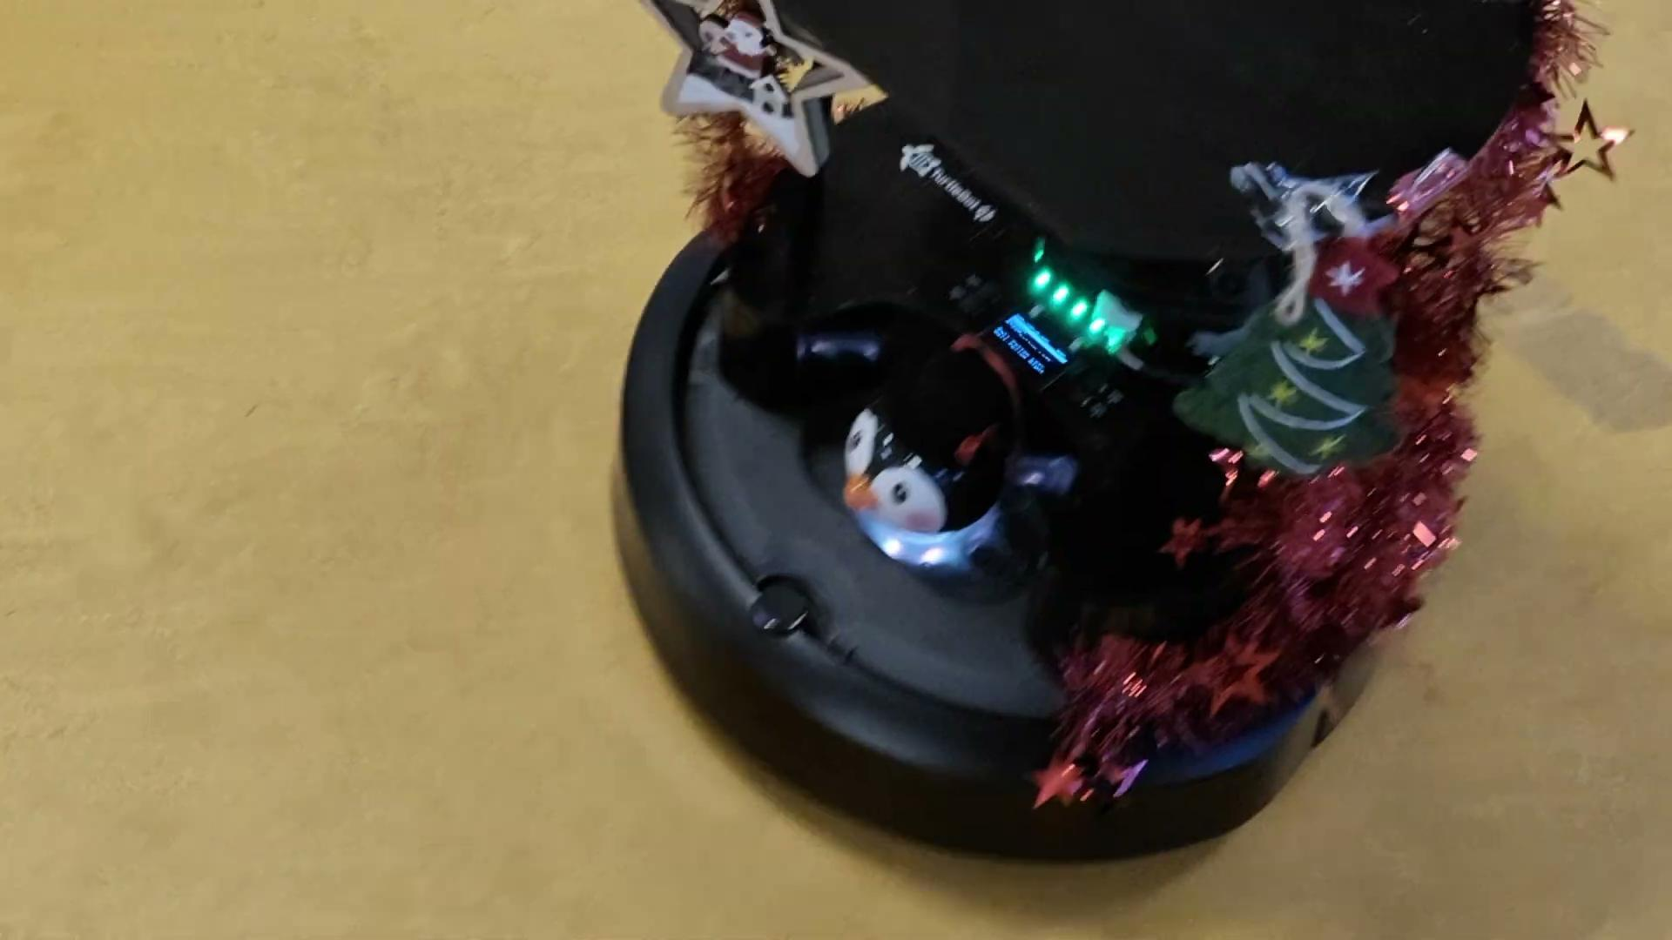
Lights when destination is reached

Slide 21
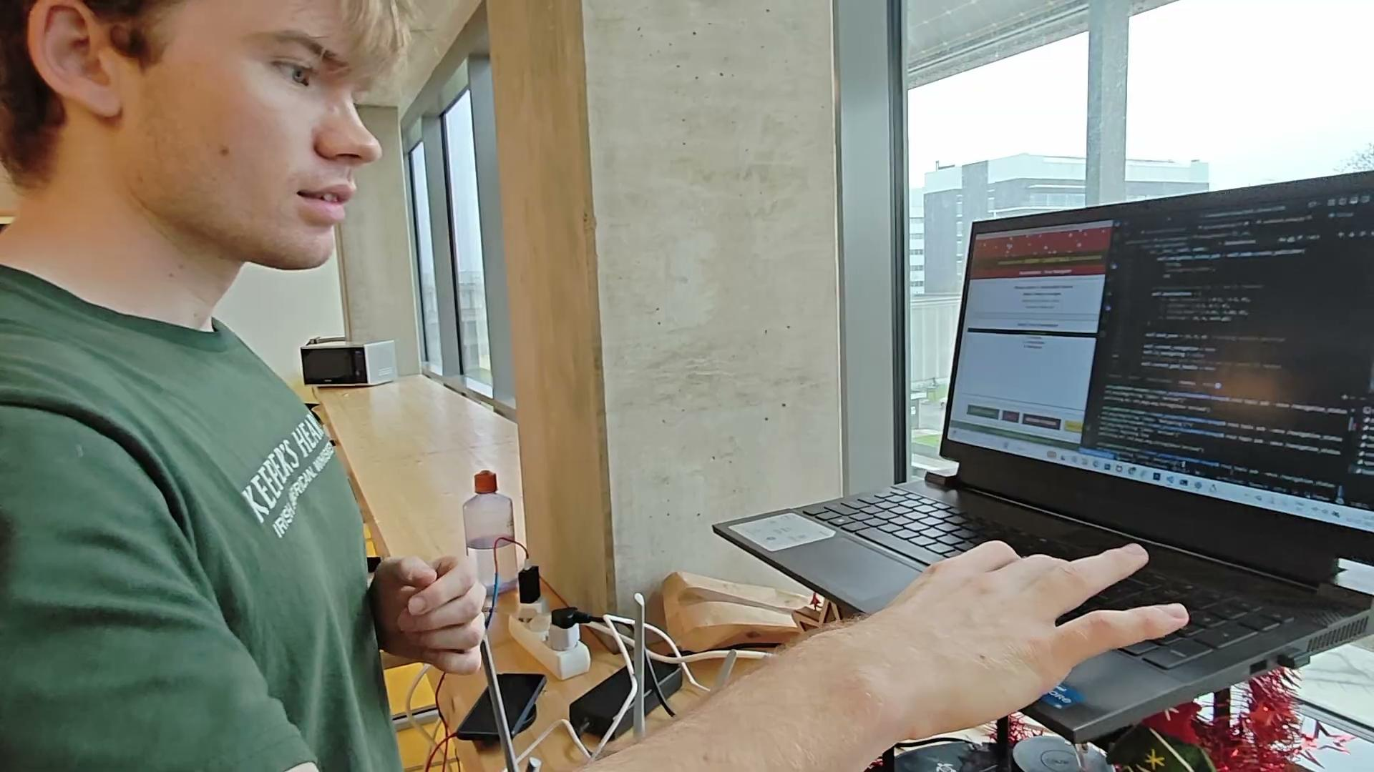
Conversation

Slide 22
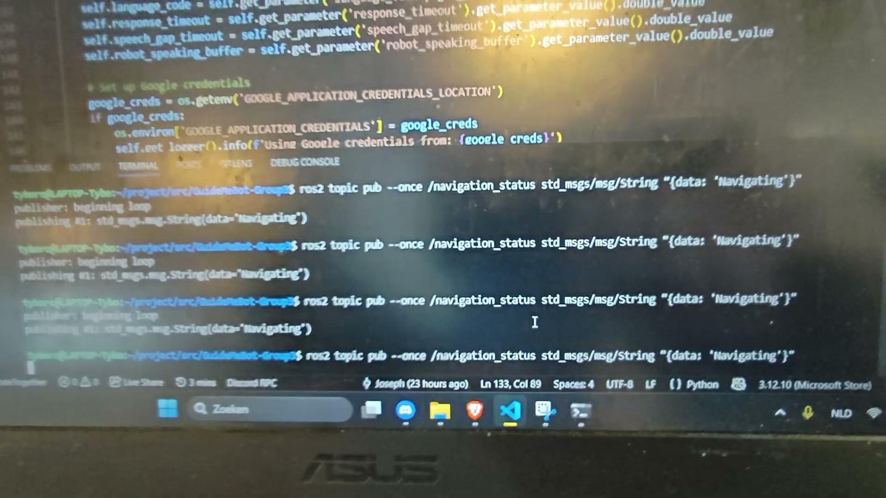
No response

Slide 23
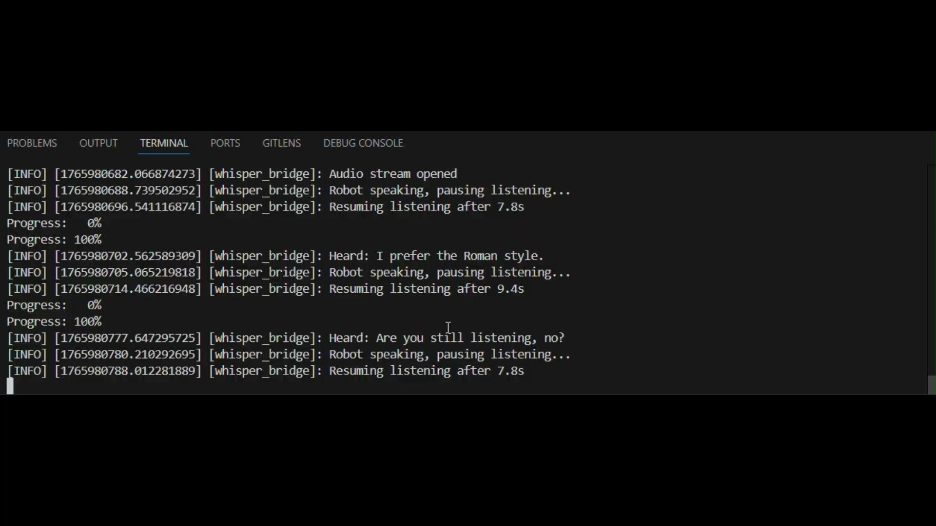
No response

Slide 24
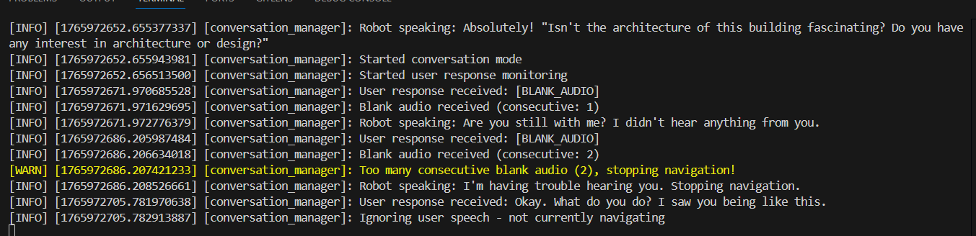
Stopping conversation with no response

Slide 25
The end!
Notes:
WSL
Connectivity - Wifi, Ethernet
Constant hardware issues with the robot
LIDAR breakdown, Comms disconnections, Motors not detected, latency in data packets transfer
Integration of navigation and conversation problems with networking
Finding a good voice
mms-tts-eng was disappointing

